Slide 1
Laptop Reviews
Your best decision is our will

Slide 2
Team member
Supervisor: Mr. Kiều Trọng Khánh
Võ Thị Minh Châu
Nguyễn Văn Hơn (Dropped out)
Đinh Hữu Toàn
Nguyễn Mạnh Khương

Slide 3
Outline
Scenario problem
Our solution
Demonstration
Advantages and disadvantages of current solution
Questions and answers
Future Plans

Slide 4




Scenario problem
Notes:
- ngta can biet thong tin de lam gi do, de tra cuu, de so sanh de tim hieu, mua...

Slide 5
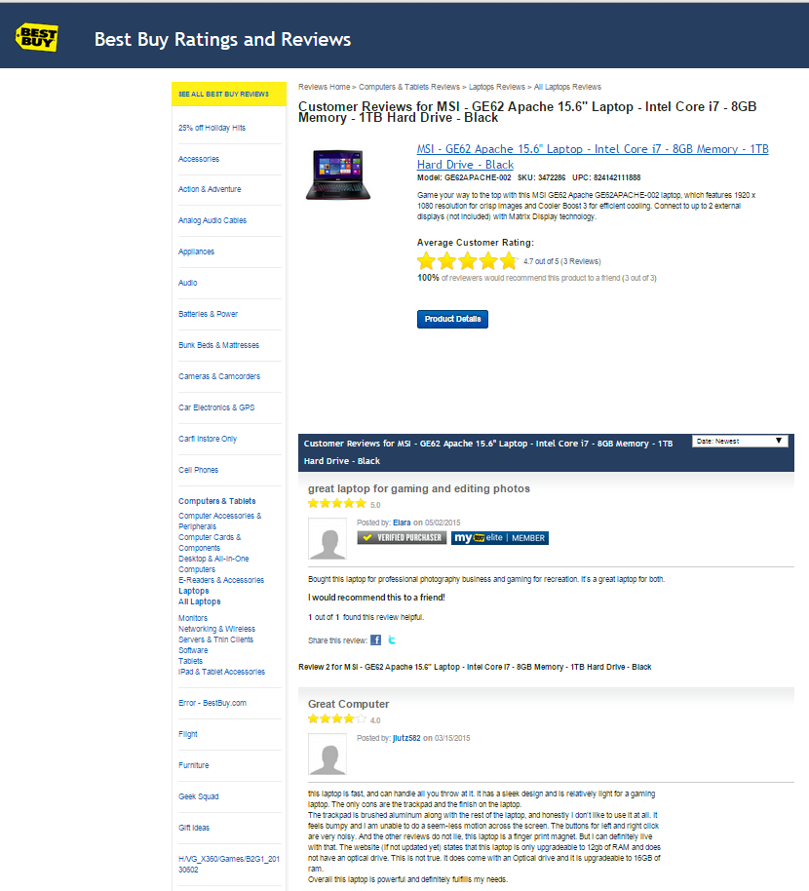
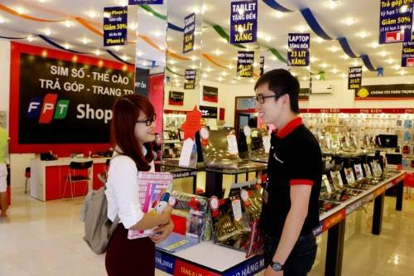
Scenario problem
Notes:
Search online các website
Nếu có thời gian thì đi ra các cửa hàng để tham quan và lấy thông tin từ đó

Slide 6
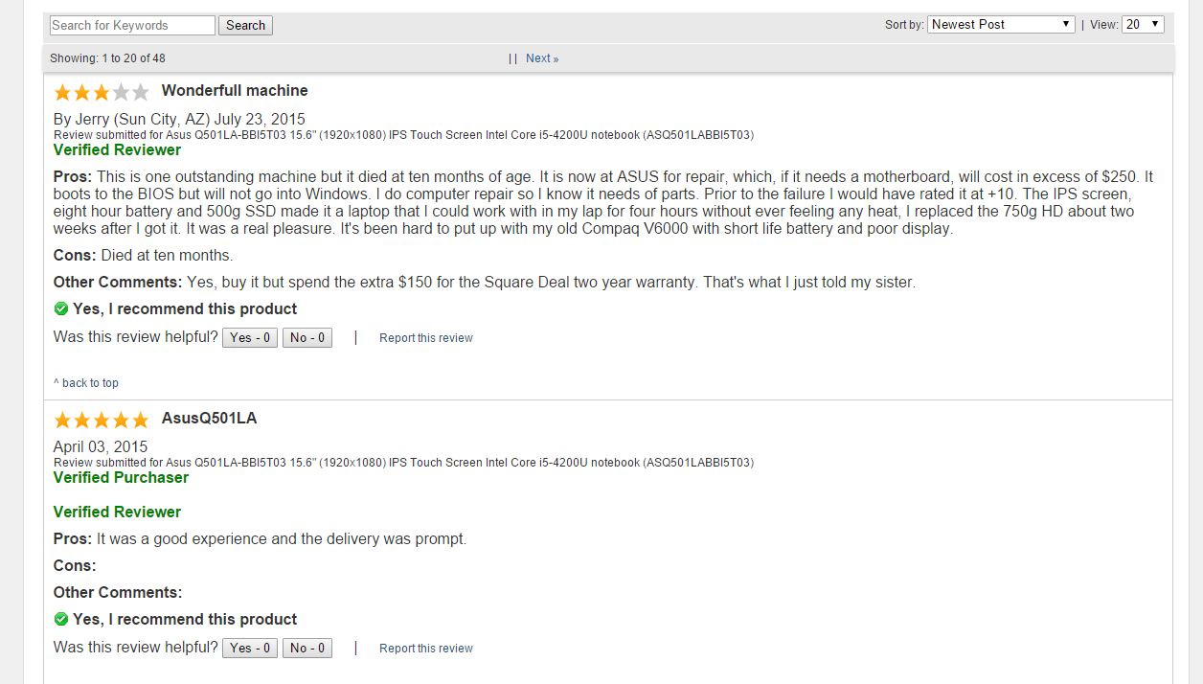
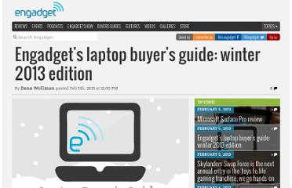
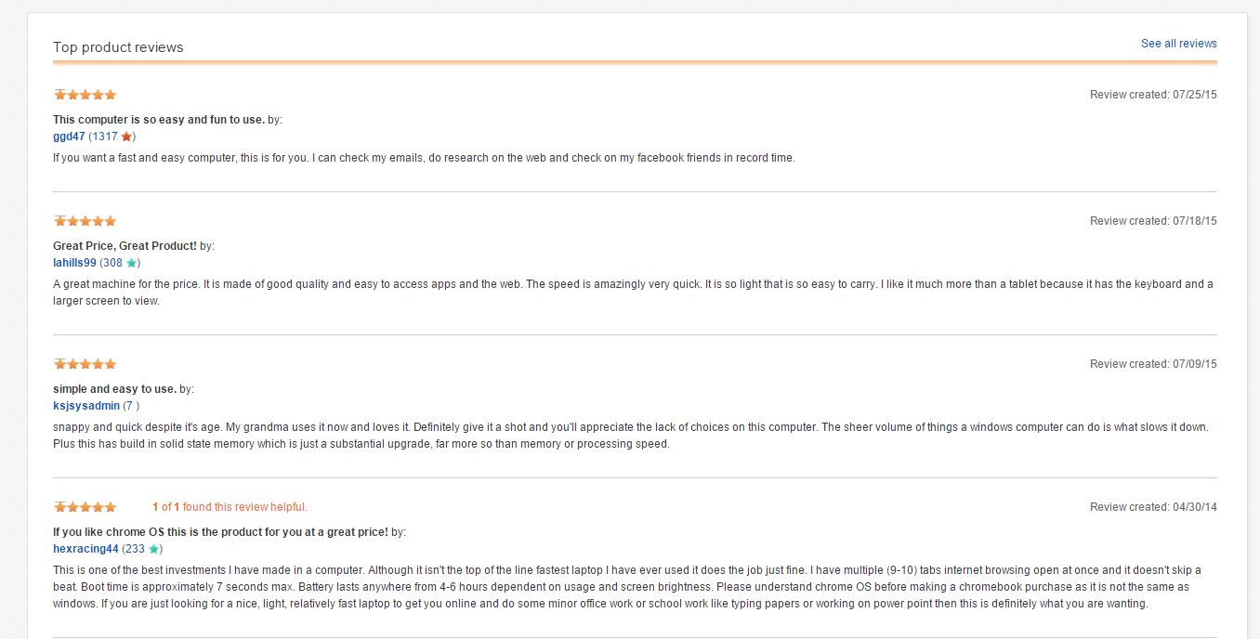
Scenario problem
Take lots of time to search for trusted websites and read all the reviews
1
Notes:
Các website không đáng tin cậy
Thông tin không chính thống, mông lung

Slide 7
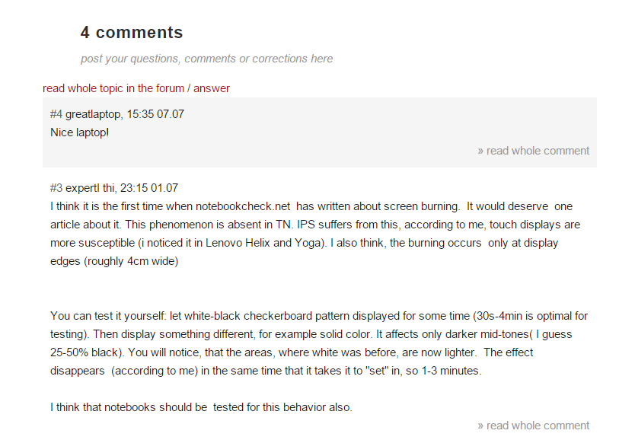

Scenario problem
2
Some reviews may be useless or not relevant.
Notes:
Các bình luận không liên quan
Bình luận không chuẩn, quá ngắn, quá dài và nhiều khi chỉ là một lời cảm thán mang nặng tính cá nhân

Slide 8

Scenario problem
Hard to remember exactly the information these supermarkets provide
3
Notes:
1. Nếu đi ra cửa hàng thì khó nhớ thông tin

Slide 9

Scenario problem
1
2
3
What is the best way to have good reviews?
Notes:
Tìm kiếm thông tin từ những trang web uy tín
Tiến hành làm sạch và chuẩn hóa các bình luận, để người dùng có thể tìm được thông tin nhanh chóng và chính xác

Slide 10
Our Solution

Slide 11


Our solution
Find trusted websites

Slide 12



Our solution
Find trusted websites
Collect information

Slide 13


Our solution
Find trusted websites
Collect information
Standardize comments
Notes:
=> giới thiệu C trình bày cách lấy dữ liệu

Slide 14
Collect Data

Slide 15
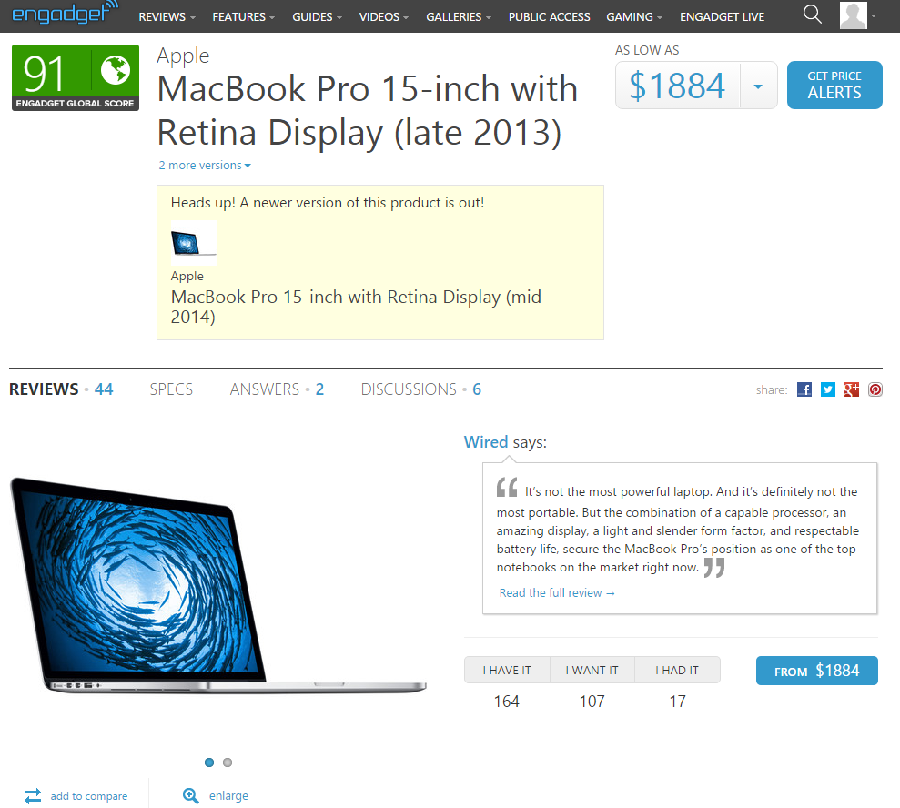
Collect Data Step 1: Find trusted website
http://www.engadget.com/
Notes:
1. de lay thong tin laptop, chung toi phai tim trang web va dua thong tin do ve
chung toi tim dc trang web engadget, day la 1 trang web co thong tin ve laptop kha chuan.

Slide 16




Collect Data Step 1: Find trusted website
Comments are approved before publishing.
Notes:
chung toi quyet dinh dung trang web tieng anh boi vi du sao tieng anh cung tot hon tieng viet
ngoai engadget con lay them 2 trang nua, vi nhung trang nay khi cmt thi phai cho staff duyet

Slide 17

Collect Data
How to get data from this site?
Notes:
va cau hoi dat ra la lam sao de lay dc thong tin tu trang web nay ve

Slide 18
Collect Data
Notes:
va cau hoi dat ra la lam sao de lay dc thong tin tu trang web nay ve

Slide 19
Collect Data
Notes:
va cau hoi dat ra la lam sao de lay dc thong tin tu trang web nay ve

Slide 20
Collect Data
Notes:
va cau hoi dat ra la lam sao de lay dc thong tin tu trang web nay ve

Slide 21
Collect Data
Notes:
va cau hoi dat ra la lam sao de lay dc thong tin tu trang web nay ve

Slide 22
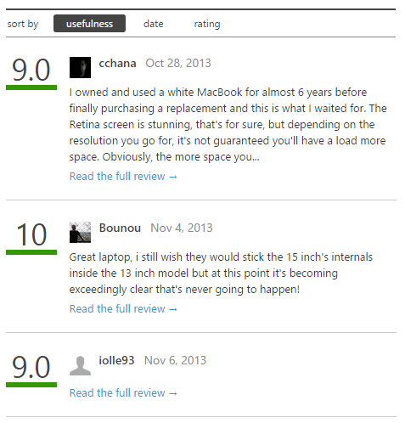
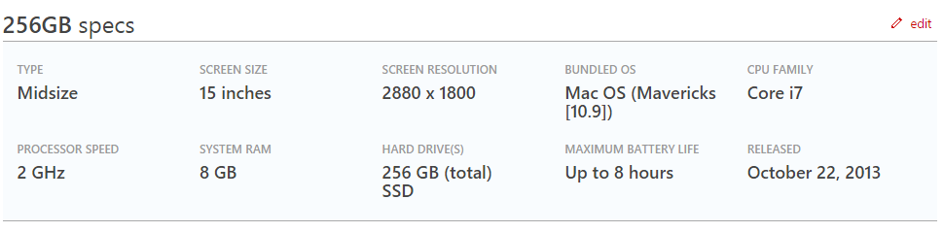
Collect Data

Slide 23
Collect Data

Slide 24
Collect Data

Slide 25
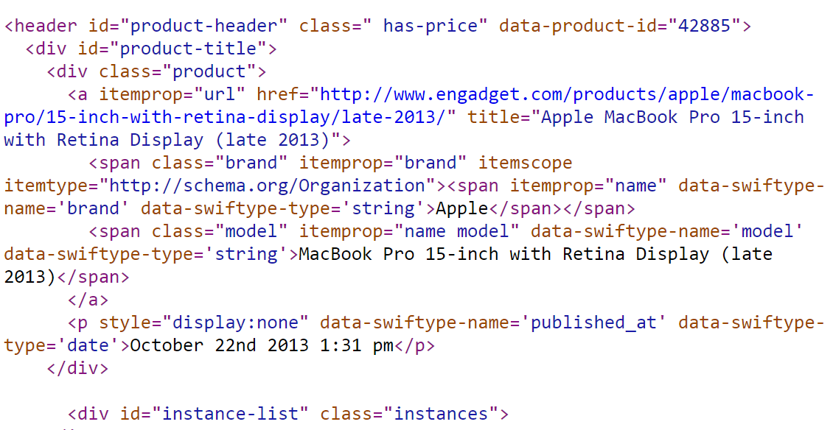
Collect Data
Notes:
show trang engadget len, cho thay trang nay co nhung thong tin: ten, brand, desc, cmt...
chup hinh trang engadget dang html. de parse dc trang html nay thi co solution gi, gap van de gi
Phan tich ra, phong ra tu trang 17. VD ra

Slide 26
Collect Data
Notes:
show trang engadget len, cho thay trang nay co nhung thong tin: ten, brand, desc, cmt...
chup hinh trang engadget dang html. de parse dc trang html nay thi co solution gi, gap van de gi
Phan tich ra, phong ra tu trang 17. VD ra

Slide 27
Collect Data
<span class="model" itemprop="name model" data-swiftype-name='model' data-swiftype-type='string'>MacBook Pro 15-inch with Retina Display (late 2013)</span>
Notes:
show trang engadget len, cho thay trang nay co nhung thong tin: ten, brand, desc, cmt...
chup hinh trang engadget dang html. de parse dc trang html nay thi co solution gi, gap van de gi
Phan tich ra, phong ra tu trang 17. VD ra

Slide 28
Collect Data
Libraries support parsing data:
Selenium
vs
HtmlAgilityPack

Slide 29

Collect Data
Libraries support parsing data:
Selenium
vs
HtmlAgilityPack
Create
simulator browser

Slide 30

Collect Data
Libraries support parsing data:
Selenium
vs
HtmlAgilityPack
Create
simulator browser
Parse data

Slide 31
Collect Data
Libraries support parsing data:
Selenium
vs
HtmlAgilityPack
Create
simulator browser
Parse data
Parse data

Slide 32

Collect Data
Libraries support parsing data:
Selenium
vs
HtmlAgilityPack
Create
simulator browser
Parse data
Decrease speed
Parse data

Slide 33
Collect Data
Libraries support parsing data:
Selenium
vs
HtmlAgilityPack
Create
simulator browser
Parse data
Decrease speed
Parse data

Slide 34

Collect Data

Slide 35

Collect Data
Take url
Remove script

Slide 36

Collect Data
Take url
Download
Remove script

Slide 37

Collect Data
Take url
Download
Remove script
Display

Slide 38
Collect Data
Take url
Download
Remove script
Display
xPath
Get
Notes:
Inspect ? => s

Slide 39
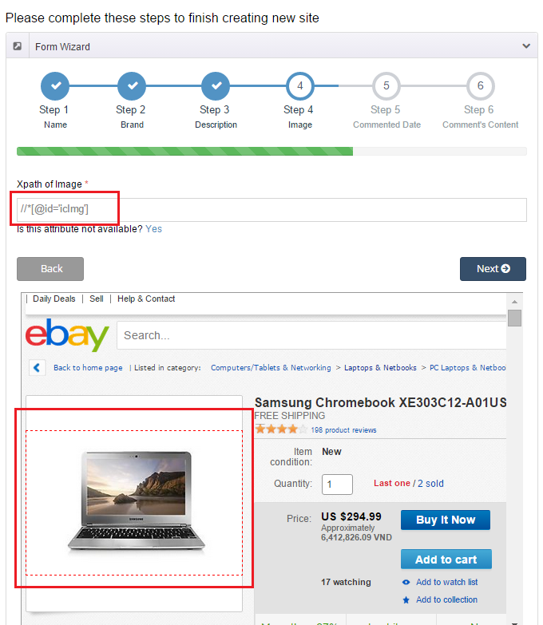

Slide 40
How to get xpath?

Slide 41
Collect Data
Step 1: From clicked node

Slide 42
Collect Data
Step 1: From clicked node
Step 2: Get parent node

Slide 43
Collect Data
Step 1: From clicked node
Step 2: Get parent node
Step 3: Stop when meeting “HTML” or “ID” node

Slide 44
Collect Data
Step 1: From clicked node
Step 2: Get parent node
Step 3: Stop when meeting “HTML” or “ID” node
Step 4: Take xPath

Slide 45
Collect Data
Step 1: From clicked node
Step 2: Get parent node
Step 3: Stop when meeting “HTML” or “ID” node
Step 4: Take xPath
Step 5: Get data

Slide 46
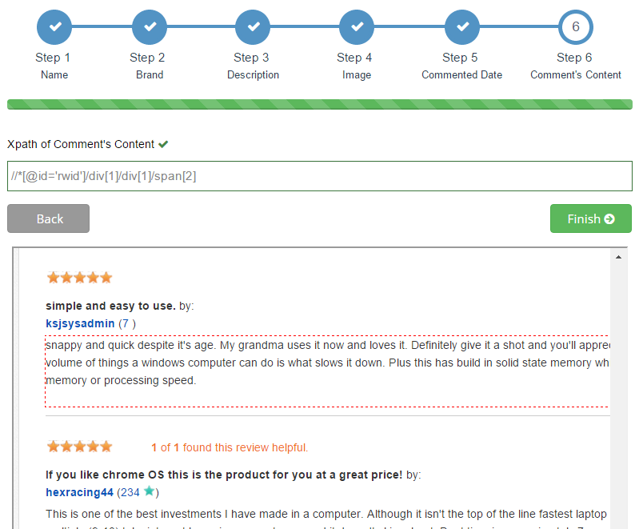
Step 1, 2 & 3: Get parent node, stop when meeting “html” or “id” node

Slide 47
Step 1, 2 & 3: Get parent node, stop when meeting “html” or “id” node
Clicked node
span[2]

Slide 48
Step 1, 2 & 3: Get parent node, stop when meeting “html” or “id” node
Parent node
Clicked node
div[1] /
span[2]

Slide 49
Step 1, 2 & 3: Get parent node, stop when meeting “html” or “id” node
Parent node
Clicked node
div[1] /
div[1] /
span[2]

Slide 50
Step 1, 2 & 3: Get parent node, stop when meeting “html” or “id” node
“id” node
Parent node
Clicked node
*[@id='rwid']/
div[1] /
div[1] /
span[2]

Slide 51
Step 1, 2 & 3: Get parent node, stop when meeting “html” or “id” node
“id” node
Parent node
Clicked node
//
*[@id='rwid']/
div[1] /
div[1] /
span[2]

Slide 52
Step 1, 2 & 3: Get parent node, stop when meeting “html” or “id” node
“id” node
Parent node
Clicked node
//
*[@id='rwid']/
div[1] /
div[1] /
span[2]
//*[@id='rwid']/div[1]/div[1]/span[2]

Slide 53
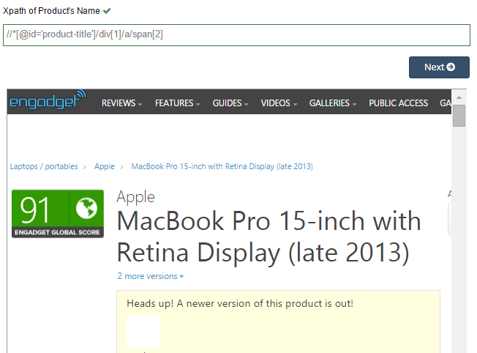
Step 4&5: Take xPath and Get data

Slide 54
Step 4&5: Take xPath and Get data

Slide 55
Step 4&5: Take xPath and Get data
MacBook Pro 15-inch with Retina Display (late 2013)

Slide 56
Step 4&5: Take xPath and Get data
MacBook Pro 15-inch with Retina Display (late 2013)
Product
Name

Slide 57
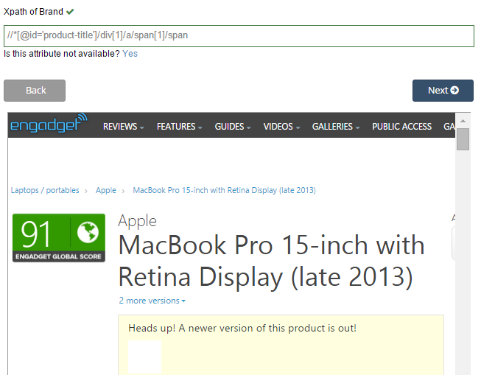
Step 4&5: Take xPath and Get data
Apple
Product
Name
Brand

Slide 58
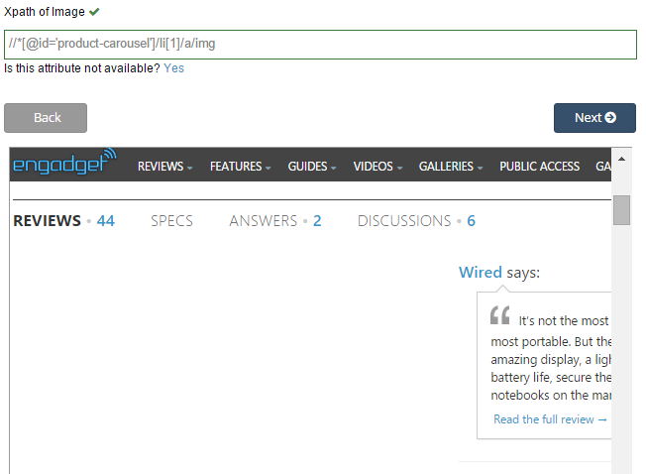


Step 4&5: Take xPath and Get data
Product
Name
Brand
Image

Slide 59
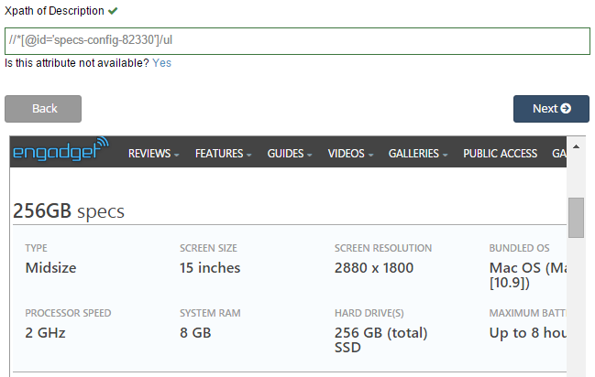
Step 4&5: Take xPath and Get data
Type: Midsize
Screen size: 15 inches
…
Product
Name
Brand
Image
Description

Slide 60
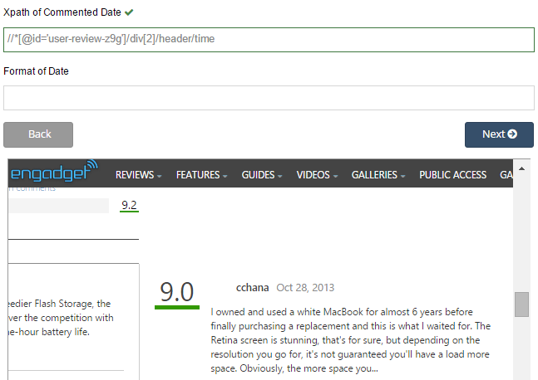
Step 4&5: Take xPath and Get data
Oct 28, 2013
Product
Name
Brand
Image
Description
Comment’s date

Slide 61
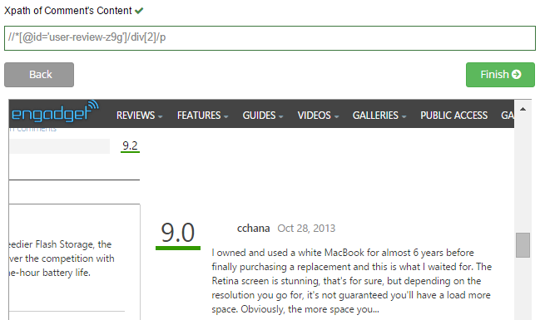
Step 4&5: Take xPath and Get data
I owned and used a white MacBook for almost 6 years before finally purchasing a replacement…
Product
Name
Brand
Image
Description
Comment’s date
Comment’s content

Slide 62
Collect Data
We have these entities
Product
Url
Name
Brand
Description
Image
Comment’s date
Comment’s content

Slide 63
Collect Data
We have these entities
Product
Url
Name
Brand
Description
Image
Last comment’s date
Comment’s content

Slide 64
Collect Data
We have these entities
Product
Site
Url
Name
Brand
Description
Image
Last comment’s date
Comment’s content
Domain
Name’s xpath
Brand’s xpath
Description’s xpath
Image’s xpath
Date’s xpath
Content’s xpath

Slide 65
Collect Data
We have these entities
Product
Site
Url
Name
Brand
Description
Image
Last comment’s date
Comment’s content
Domain
Name’s xpath
Brand’s xpath
Description’s xpath
Image’s xpath
Date’s xpath
Content’s xpath
0..*
1..*
2 different websites have a laptop with different information.
Notes:
trong qua trinh collection du lieu, chung toi da nhan thay dc 1 dieu: 2 trang web khac nhau voi cung 1 laptop co thong tin khac nhau. vi vay chung toi moi nghi ra cach
problem

Slide 66
Collect Data
We have these entities
Product
Site
Brand
Description
Image
Domain
Name’s xpath
Brand’s xpath
Description’s xpath
Image’s xpath
Date’s xpath
Content’s xpath
0..*
1..*
Alias Product
Url
Name
Last comment’s date
Content’s xpath

Slide 67
Detect Duplicated Product

Slide 68
Detect Duplicated Product String Comparision

Slide 69
Detect Duplicated Product String Comparision
Step 1: Split into a list of character pairs

Slide 70
Detect Duplicated Product String Comparision
Step 1: Split into a list of character pairs
Step 2: Count how many adjacent character pairs

Slide 71
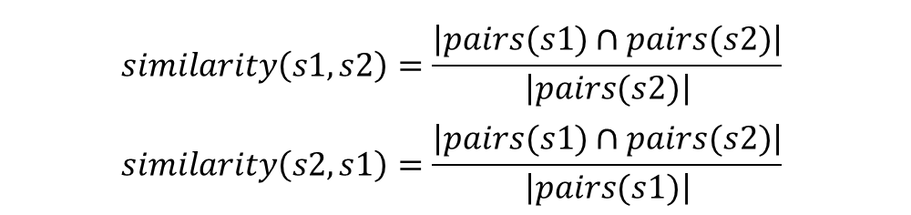
Detect Duplicated Product String Comparision
Step 1: Split into a list of character pairs
Step 2: Count how many adjacent character pairs
Step 3: Calculate matching percent
$$similarity\left(s1,s2\right)=\frac{\left|pairs(s1)∩pairs(s2)\right|}{\left|pairs(s2)\right|}$$
$$similarity\left(s2,s1\right)=\frac{\left|pairs(s1)∩pairs(s2)\right|}{\left|pairs(s1)\right|}$$

Slide 72
Detect Duplicated Product String Comparision
s1
s2
MacBook Air 2015
MacBook Air 2015 Retina

Slide 73
Detect Duplicated Product String Comparision
s1
s2
MacBook Air 2015
MacBook Air 2015 Retina
MACBOOK AIR 2015
MACBOOK AIR 2015 RETINA

Slide 74
Detect Duplicated Product String Comparision
s1
s2
MacBook Air 2015
MacBook Air 2015 Retina
MACBOOK AIR 2015
MACBOOK AIR 2015 RETINA
$$\left\{MA,AC,CB,BO,OO,OK,AI,IR,20,01,15\right\}$$
$$\left\{MA,AC,CB,BO,OO,OK,AI,IR,20,01,15,RE,ET,TI,IN,NA\right\}$$

Slide 75
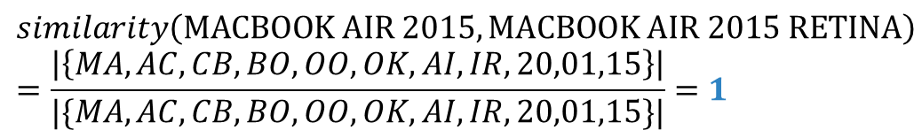
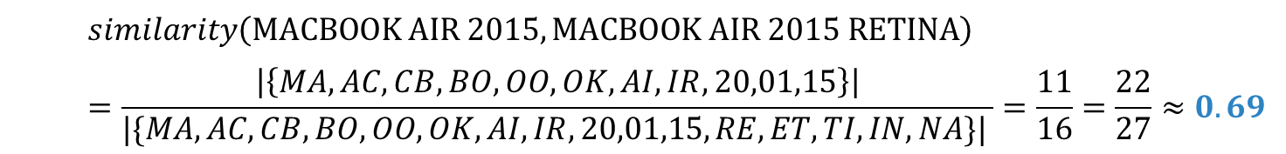
Detect Duplicated Product String Comparision
s1
s2
MacBook Air 2015
MacBook Air 2015 Retina
MACBOOK AIR 2015
MACBOOK AIR 2015 RETINA
$$\left\{MA,AC,CB,BO,OO,OK,AI,IR,20,01,15\right\}$$
$$\left\{MA,AC,CB,BO,OO,OK,AI,IR,20,01,15,RE,ET,TI,IN,NA\right\}$$
$$similarity\left(MACBOOK AIR 2015,MACBOOK AIR 2015 RETINA\right)=\frac{\left|\left\{MA,AC,CB,BO,OO,OK,AI,IR,20,01,15\right\}\right|}{|\{MA,AC,CB,BO,OO,OK,AI,IR,20,01,15,RE,ET,TI,IN,NA\}| }=\frac{11}{16}=\frac{22}{27}≈0.69$$
$$similarity\left(MACBOOK AIR 2015,MACBOOK AIR 2015 RETINA\right)=\frac{\left|\left\{MA,AC,CB,BO,OO,OK,AI,IR,20,01,15\right\}\right|}{|\{MA,AC,CB,BO,OO,OK,AI,IR,20,01,15\}|}=1$$
Notes:
Them ct min

Slide 76
Detect Duplicated Product String Comparision
$$min⁡(similarity\left(s1, s2), similarity(s2, s1)\right)=\min\left(0.69, 1\right)=0.69$$
similarity = 69 %

Slide 77

Detect Duplicated Product
New laptop

Slide 78

Detect Duplicated Product
New laptop
Data object
Database

Slide 79
Detect Duplicated Product
New laptop
Data object
Database

Slide 80
Detect Duplicated Product
New laptop
Data object
Database
is new
different brand
+
similarity < 40%
Notes:
Cùng brand và > 40%

Slide 81

Detect Duplicated Product
New laptop
Data object
Database
is new
different brand
+
similarity < 40%
true
Notes:
dk

Slide 82
Detect Duplicated Product
New laptop
Data object
Database
is new
false
different brand
+
similarity < 40%
true

Slide 83

Detect Duplicated Product
New laptop
Data object
Database
is new
false
different brand
+
similarity < 40%
true
save
Notes:
Giới thiệu T trình bày cách xử lý sp trùng

Slide 84







Handle Duplicated Product
Main
Alias
Database
Description
Description
Save
Comments
Comments
Images
Images
Merge
Main

Slide 85


Handle Duplicated Product
MacBook Pro 12' 2015
Notes:
Sau qua trinh parse, he thong tim duoc

Slide 86



Handle Duplicated Product
Database
MacBook Pro 12' 2015
MacBook (early 2015)
Notes:
… Sau do so voi db … sau do

Slide 87
Handle Duplicated Product
Database
MacBook Pro 12' 2015
MacBook (early 2015)
Notes:
Giong nhau

Slide 88
Handle Duplicated Product
Database
MacBook Pro 12' 2015
MacBook (early 2015)
Notes:
San pham chinh o db co id la …

Slide 89
Handle Duplicated Product
Database
MacBook Pro 12' 2015
MacBook (early 2015)
Notes:
Sau khi merge, san pham phu luu vao alias, co product id la id cua sp chinh, sp chinh se dc danh dau la main

Slide 90

Handle Duplicated Product – After merging
Main laptop name
Search
Main
Guest
Alias laptop name

Slide 91

Handle Duplicated Product
Alias 1
Alias 2
Database
Description
Description
Save
Save
Comments
Comments
Images
Images
Split
New Laptop
New Laptop

Slide 92
Analyze Comment

Slide 93


Analyze Comment
In real life
How can system classify the comments?
Can we train it?
Notes:
Phân tích bình luận
Ở ngoài, có thể hiểu đc qua quá trình học tập từ nhỏ
Vậy làm sao máy hiểu

Slide 94

Analyze Comment
Notes:
Ask English teacher

Slide 95

Analyze Comment
WORDS
4.Other
1.Adjective/
Adverb
3.Noun
2.Verb
Meaning
Totally
Pros
Pros
Cons
Negative
Neutral

Slide 96


Analyze Comment – Get words for database
Word Name (Character of word)
Read
WORDS
Word Classes
(Adjective, Adverb,
Verb, Noun, Other)
Staff
Word Types
(Totally Pros, Pros, Cons,
Neutral, Negative)
Notes:
Nguoi nhan vien se doc 100 binh luan tu trang web uy tín
Sau đó lọc ra nội dung các từ. Nội dung này bao gồm: từ, từ loại và ý nghĩa của từ

Slide 97

Analyze Comment – Get words for database
Word Name
Word Types
Totally Pros, Pros, Cons, Neutral, Negative
Database
Word Classes
Adjective, Adverb, Verb, Noun, Other
Notes:
Sau đó lưu vào db

Slide 98




Analyze Comment – Get words for database
+
+
=
Database
System
Better Database
Notes:
Từ vốn từ có sẵn, kết hợp với lingoes để tìm các từ đồng nghĩa trái nghĩa của những từ trong vốn từ có sẵn, làm giàu vốn từ

Slide 99

Analyze Comment
Read
Staff
Classify
System
WORDS
Better Database
Database

Slide 100



Analyze Comment
Classified
Comment
Negative
Negative
Flag
Collect and Split
into words
System
Totally Pros
WORDS
Compare
Database

Slide 101

Analyze Comment - Example
Although the speed is slow, I still love this laptop
System
“although” ,”the” , “speed”, ‘is”, “slow”, “I”, “still”, “love”, “this”, “laptop”
Split into words
Compare
Totally Pros
“love”
“slow”,
“love”
Database
Positive Comment

Slide 102

Analyze Comment – Check Adjectives/Adverbs
Good Flag
Neutral
Flag
Classified
Comment
Negative
Bad Flag
Negative
Flag
Collect and Split
into words
System
Adjective/Adverb
Pros/Cons
Neutral
WORDS
Compare
Database

Slide 103
Analyze Comment - Example
Despite slow speed, the screen is beautiful and the keyboard is good
System
“despite”, “slow”, “speed”, “the”, “screen”, “is”, “beautiful”, “and”, “the”, “keyboard”, “is”, “good”
Split into words
Pros
Compare
Good Flag
Adjective/Adverb
“good”
“slow”,
“beautiful”,
“good”
+
“beautiful”
Pros
Database
Good Flag
Adjective/Adverb
“slow”
<
Positive
comment
Cons
Bad Flag
Adjective/Adverb

Slide 104
Analyze Comment – Check Verbs
Good Flag
Neutral
Flag
Classified
Comment
Negative
Bad Flag
Negative
Flag
Collect and Split
into words
System
Verb
Pros/Cons
Neutral
WORDS
Compare
Database

Slide 105
Analyze Comment - Example
I don’t like this laptop
System
“I”, “don’t”, “like”, “this”, “laptop”
Split into words
Compare
Negative
Negative
Flag
“don’t”
“don’t”,
“like”
“like”
Pros
Database
Good Flag
Verb
Negative
comment

Slide 106
Analyze Comment – Check Nouns
Good Flag
Neutral
Flag
Classified
Comment
Negative
Bad Flag
Negative
Flag
Collect and Split
into words
System
Noun
Pros/Cons
Neutral
WORDS
Compare
Database

Slide 107
Analyze Comment - Example
I have no problem with this laptop
System
“I”, “have”, “no”, “problem”, “with”, “this”, “laptop”
Split into words
Compare
Negative
Negative
Flag
“no”
“no”,
“problem”
“problem”
Cons
Bad Flag
Noun
Database
Positive
comment

Slide 108
Analyze Comment - After checking all word’s classes
Neutral
Flag
Neutral Comment

Slide 109
Analyze Comment - Example
I bought this laptop a year ago
System
“I”, “bought”, “this”, “laptop”, “a”, “year“, “ago”
Split into words
Compare
“bought”
“bought”
Neutral
Neutral
Flag
Verb
Database
Neutral
comment

Slide 110

Analyze Comment - Summary
Classified
Words
Read and classify
words
Staff
System
Database
Classified
comments
Compare with
classified words
System
WORDS
Collect and Split
into words
Raw Comments

Slide 111
Our Solution - Summary

Slide 112


Our solution - Summary
Collect
Classify
System
Laptops with comments
Comments

Slide 113
Features
Search
Report comment
Recommend product
Classify comment
Import Excel
Get data from web
Mobile application

Slide 114
Demonstration

Slide 115
Demonstration
Scenario 1: Search laptop and report comment
Guest

Slide 116

Demonstration
Scenario 1: Search laptop and report comment
Search
Guest

Slide 117
Demonstration
Scenario 1: Search laptop and report comment
Search
Read comments
Guest

Slide 118


Demonstration
Scenario 1: Search laptop and report comment
Search
Read comments
Guest
Report

Slide 119

Demonstration
Scenario 1: Search laptop and report comment
Search
Read comments
Guest
Report
Handle
Staff

Slide 120



Search and parse recommended product automatically

Slide 121
Search and parse recommended product automatically
order by report times

Slide 122
Search and parse recommended product automatically
order by report times

Slide 123

Search and parse recommended product automatically

Slide 124



Search and parse recommended product automatically

Slide 125

Search and parse recommended product automatically
Url of
recommended product
Search

Slide 126
Search and parse recommended product automatically
Url of
recommended product
Search
Parse data

Slide 127

Search and parse recommended product automatically
Url of
recommended product
Search
Parse data
Send email

Slide 128
Demonstration
Scenario 2: Search laptop and recommend laptop – System handle
Guest

Slide 129
Demonstration
Scenario 2: Search laptop and recommend laptop – System handle
Search
Guest

Slide 130

Demonstration
Scenario 2: Search laptop and recommend laptop – System handle
Search
(no result)
Guest

Slide 131

Demonstration
Scenario 2: Search laptop and recommend laptop – System handle
Search
(no result)
Guest
Recommend

Slide 132
Demonstration
Scenario 2: Search laptop and recommend laptop – System handle
Search
(no result)
Guest
Recommend
Handle
System
Notes:
Chuyen wa email, demo

Slide 133
Demonstration
Scenario 2: Search laptop and recommend laptop – System handle
Search
(no result)
Guest
Recommend
Send email
Handle
System
Notes:
Chuyen wa email, demo

Slide 134
Demonstration
Scenario 3: Search laptop and recommend laptop – Staff handle
Search
(no result)
Guest
Recommend
Notes:
Gioi thieu T demo train machine.

Slide 135
Demonstration
Scenario 3: Search laptop and recommend laptop – Staff handle
Search
(no result)
Guest
Recommend
Handle
Staff
Notes:
Gioi thieu T demo train machine.

Slide 136
Demonstration
Scenario 3: Search laptop and recommend laptop – Staff handle
Search
(no result)
Guest
Recommend
Handle
Send email
Staff
Notes:
Gioi thieu T demo train machine.

Slide 137
Demonstration
Scenario 4: Parse data and handle duplicated products
Parse
System

Slide 138
Demonstration
Scenario 4: Parse data and handle duplicated products
Parse
Handle
Staff
System

Slide 139
Mobile Application

Slide 140

Mobile Application - Situation
Guest
Smart Phone

Slide 141




Mobile Application - Situation
81.5%
14.8%
Guest
2.7%
Smart Phone
Other
1%

Slide 142


Mobile Application - Situation
Focus
Guest
LRA
Android Mobile Phone

Slide 143
Mobile Application – How to communicate with the system ?

Slide 144

Mobile Application – How to communicate with the system ?
Provide
APIs
System

Slide 145

Mobile Application – How to communicate with the system ?
Provide
APIs
Request
System
LRA
Volley Library Android

Slide 146
Mobile Application – How to communicate with the system ?
Provide
APIs
Request
System
Respond
LRA
Volley Library Android

Slide 147


Mobile Application – Search Product
Search
Guest
LRA

Slide 148
Mobile Application – Search Product
Request
Search
Guest
APIs
LRA

Slide 149
Mobile Application – Search Product
Request
Search
Guest
APIs
LRA
Find
System

Slide 150
Mobile Application – Search Product
Request
Search
Guest
APIs
LRA
Result
Find
System

Slide 151
Mobile Application – Search Product
Request
Search
Respond
Guest
APIs
LRA
Result
Find
System

Slide 152
Mobile Application
Features
Search
Report comment
Recommend product
Write comment
Add favorite product

Slide 153
Mobile Application
Features
Search
Report comment
Recommend product
Write comment
Add favorite product

Slide 154
Mobile Application – Write Comment
After search product:
Write comment
Guest
LRA

Slide 155
Mobile Application – Write Comment
After search product:
Request
Write comment
Guest
APIs
LRA

Slide 156
Mobile Application – Write Comment
After search product:
Request
Write comment
Guest
APIs
LRA
Add Comment
System

Slide 157
Mobile Application – Write Comment
After search product:
Request
Write comment
Guest
APIs
LRA
Response
Add Comment
System

Slide 158
Mobile Application – Write Comment
After search product:
Request
Write comment
Respond
Guest
APIs
LRA
Response
Add Comment
System

Slide 159
Mobile Application – Add Favourite Product
After search product:
Add Product to Favourite List
Guest
LRA

Slide 160

Mobile Application – Add Favourite Product
After search product:
Add Product to Favourite List
Save Information
Guest
LRA

Slide 161
Mobile Application – View Favourite List
After add product to favourite list :
View Favourite List
Guest
LRA

Slide 162
Mobile Application – View Favourite List
After add product to favourite list :
Load Information
View Favourite List
Guest
LRA

Slide 163
Mobile Application – View Favourite List
After add product to favourite list :
Load Information
View Favourite List
Result
Guest
LRA

Slide 164
Demonstration
Scenario 5: Search laptop and write comment
Search
Guest

Slide 165
Demonstration
Scenario 5: Search laptop and write comment
Search
Guest
Read comments

Slide 166

Demonstration
Scenario 5: Search laptop and write comment
Search
Guest
Read comments
Add favorite

Slide 167

Demonstration
Scenario 5: Search laptop and write comment
Search
Guest
Read comments
Add favorite
Write

Slide 168
Demonstration
<Mobile>: Search laptop and report comment
Search
Read comments
Guest
Report
Handle
Staff

Slide 169
Demonstration
<Mobile>: Search laptop and recommend laptop
Search
(no result)
Guest
Recommend
Send email
Handle
System

Slide 170
Features that haven’t shown
Import excel file
Import dictionary file
Parse Specific laptop
Force Parse Data
Re-analyze comments
Auto cancel recommended product
Manage product
Manage dictionary
Manage account
Manage profile
Mobile: Report comment
Mobile: Recommend product

Slide 171
Advantages AND Disadvantages
Advantages:
Collect data from trusted resources
Provide classified comments
Training machine (work with duplicate products).
Guest can contribute to standardize comments
Guest can suggest new laptops

Slide 172
Advantages AND Disadvantages
Disadvantages:
Lack of source websites
Analyzing algorithm is not optimized. Some comments cannot be classified correctly.
Haven’t had auto-update dictionary function.
Mobile application is developed for Android Platform.

Slide 173
Future plans
Enrich words in database to have better analyzing.
Build automatic mechanism to update words in database
Use for other fields such as mobile reviews or any business fields that need to collect user reviews/behaviors and classify them for some business purposes.
Support more mobile platforms such as Windows Phone or iOS.
Notes:
1. Mở rộng database, tăng số vốn từ

Slide 174


Slide 175
Thank You!

